Slide 1


Royal Caribbean International
WTD Analytics & Trend Tracker
A comprehensive analysis of booking patterns and revenue optimization strategies based on Week-To-Date (WTD) performance metrics.
Jiaman Li
June 19, 2025
JL

Slide 2
Table of Contents
PART I
Objectives
3-Step Approach
Step 1: Exploratory Data Analysis (EDA)
Step 2: WTD Analytics & Trend Tracker Dashboard
Step 3: Business Analytics & Insights
Insight I - Risk Impact of Inaccurate WTD Expectations
Insight II - Booking Patterns by Cruise Type
PART II
SQL Queries for Revenue Management
Reference

Slide 3



PART I Objectives
To support smarter revenue management, we need to understand how bookings build week-to-date and compare that to realistic targets.
What is the expected WTD ratio for each product?
How do bookings build by weekday and sailing period?
How can these insights help managers make timely pricing or inventory decisions?

Slide 4






PART I Tools & Methodology
Step 1: Exploratory Data Analysis
Clean and analyze historical booking data using Python(pandas, seaborn, matplotlib) tools
to identify patterns.
Step 2: WTD Analytics & Trend Tracker Dashboard
Build interactive visualizations to track real-time booking performance.
Step 3: Business Analytics & Insights
Derive actionable revenue optimization strategies from the data.

Slide 5

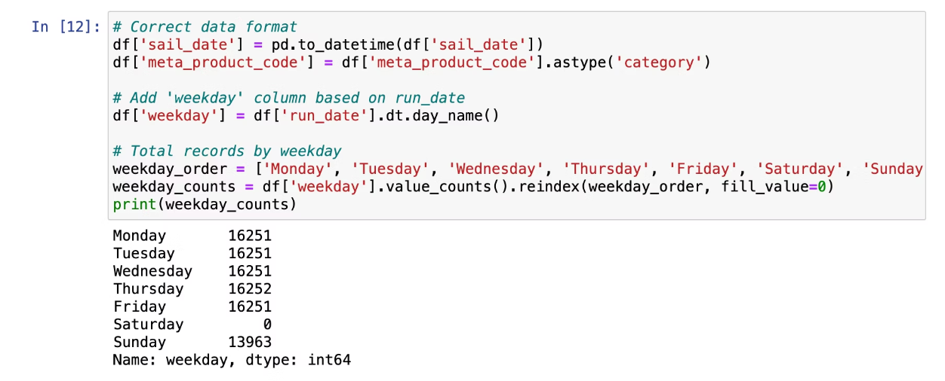
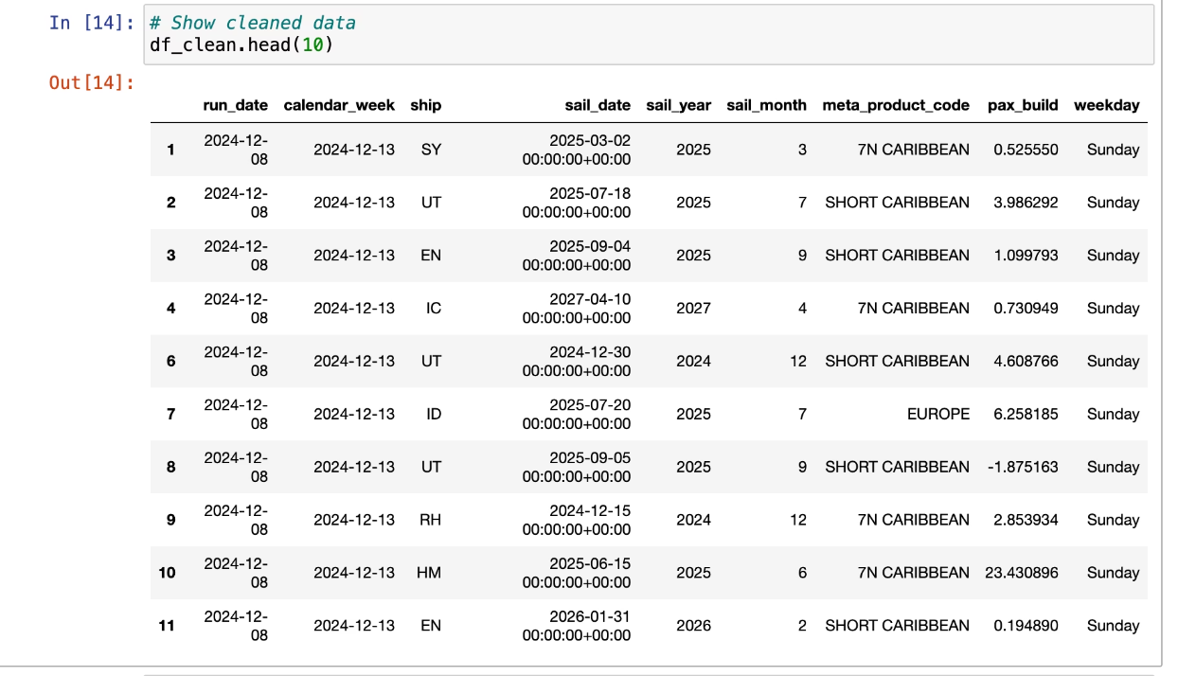
Step 1: Exploratory Data Analysis (EDA)
Tools Used:
Python ecosystem with pandas, matplotlib.pyplot, and seaborn
for data manipulation and visualization.
Key Step:
Added 'weekday' column based on run_date to identify daily
patterns.
Note: Saturday shown as 0 due to no run activity captured on that day.

Slide 6
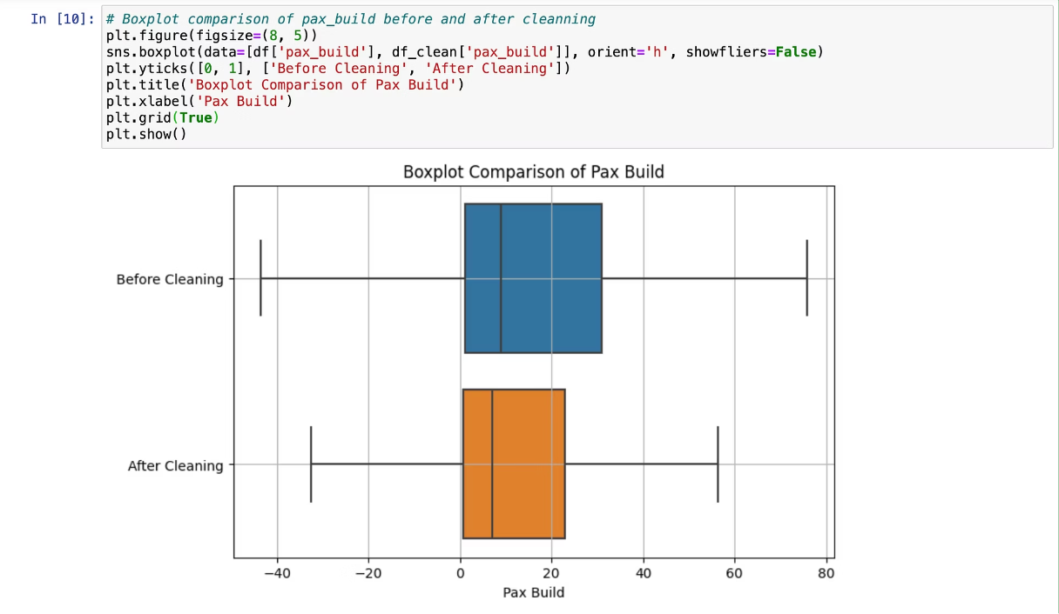
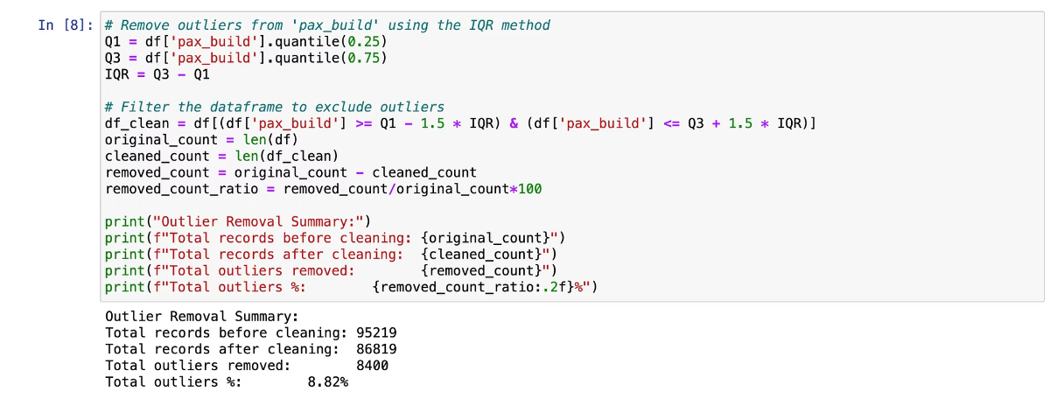
Step 1: Exploratory Data Analysis (EDA)
Key Step:
Extreme outliers in passenger build were identified and removed using Interquartile Range (IQR) method.
This improved data quality and ensured more accurate trend analysis.

Slide 7

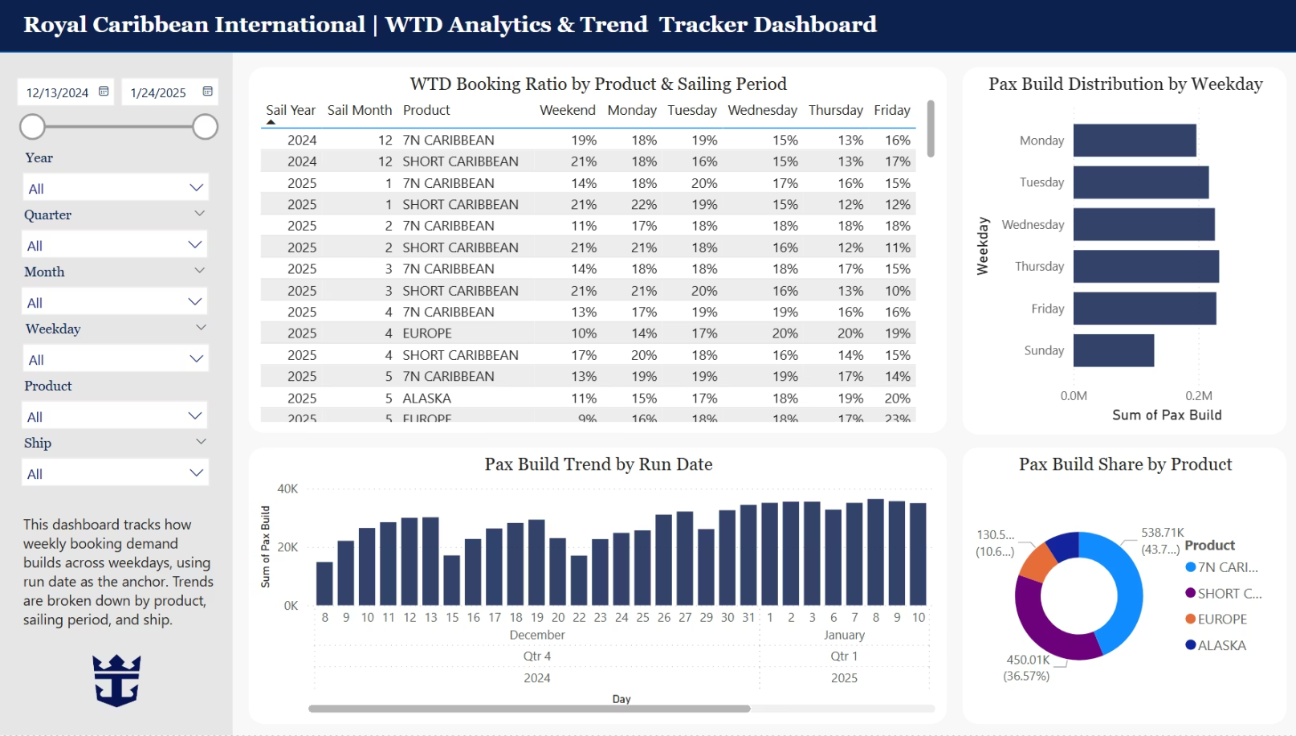



Step 2: WTD Analytics & Trend Tracker Dashboard
Interactive Visualization
Temporal Analysis
Product Segmentation
Real-time tracking of booking performance against WTD targets across products.
Daily and weekly booking patterns displayed for strategic pricing decisions.
Separate tracking for different cruise types to identify product-specific trends.

Slide 8
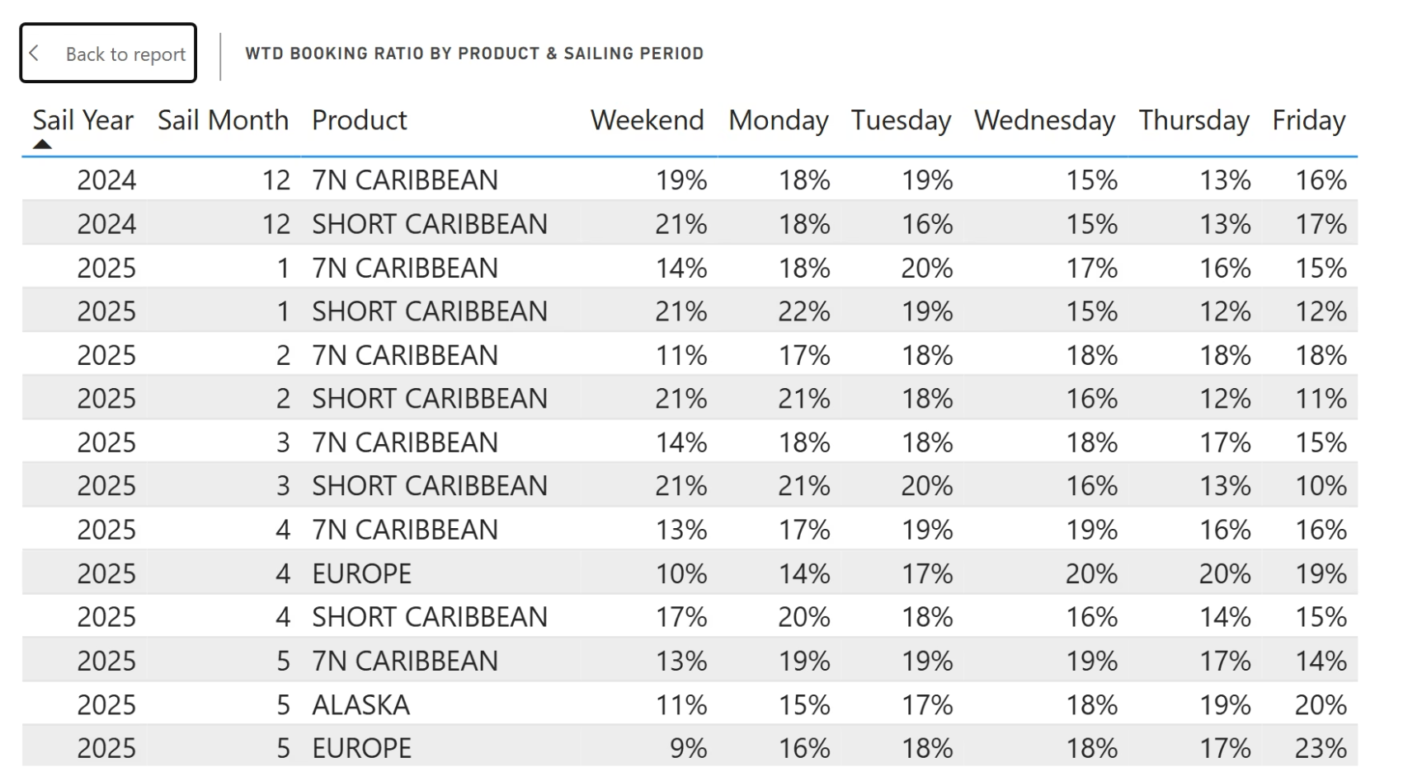

Step 3: Business Analytics & Insights
Insight I - Risk Impact of Inaccurate WTD Expectations
Overestimated WTD
Inventory held too long, resulting in last-minute discounting and missed revenue opportunities.
Underestimated WTD
Premature discounting leads to reduced revenue per passenger and margin erosion.
Recommendation
Use WTD benchmarks to guide pricing. Monitor pacing weekly to optimize fill rates and margins.
Click to download the ‘WTD Booking Ratio by Product & Sailing Period.csv’

Slide 9
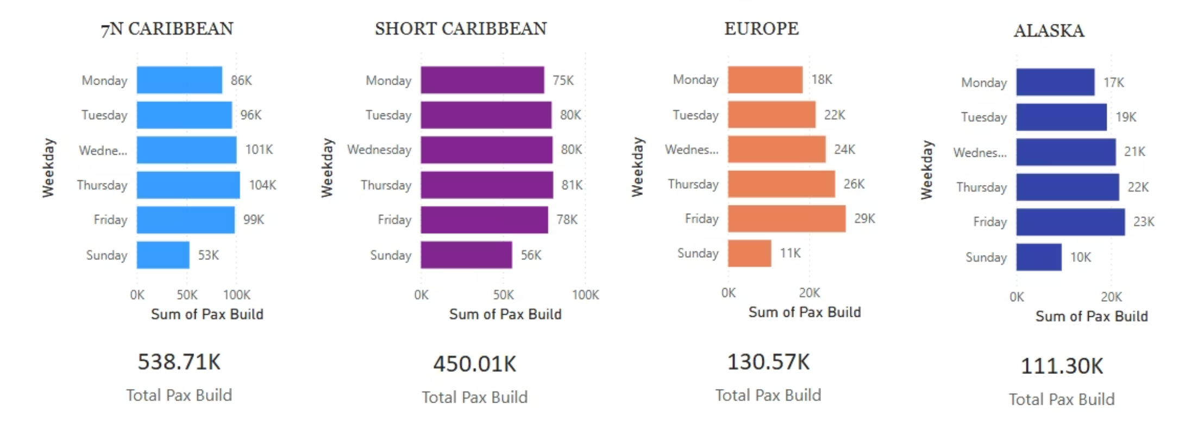




Overview: Total Pax Build varies significantly across products.
Insight II - Differences in weekday booking patterns reflect operational setups (e.g., RM cadence), market behaviors (e.g., EMEA time zones), and product characteristics (e.g., B2C vs B2B demand mix).
Caribbean products show strong midweek activity (Tues–Fri), reflecting higher B2C volume and structured Revenue Management workflows.
Europe builds gradually toward Friday, possibly due to EMEA time zone lag and regional consumer booking habits.
Alaska shows a flatter, low-volume trend, suggesting B2B-oriented demand or fewer sailing opportunities.
Sunday has the lowest activity across all products; Saturday data is structurally missing.

Slide 10
PART II Appendix: SQL Queries

Slide 11
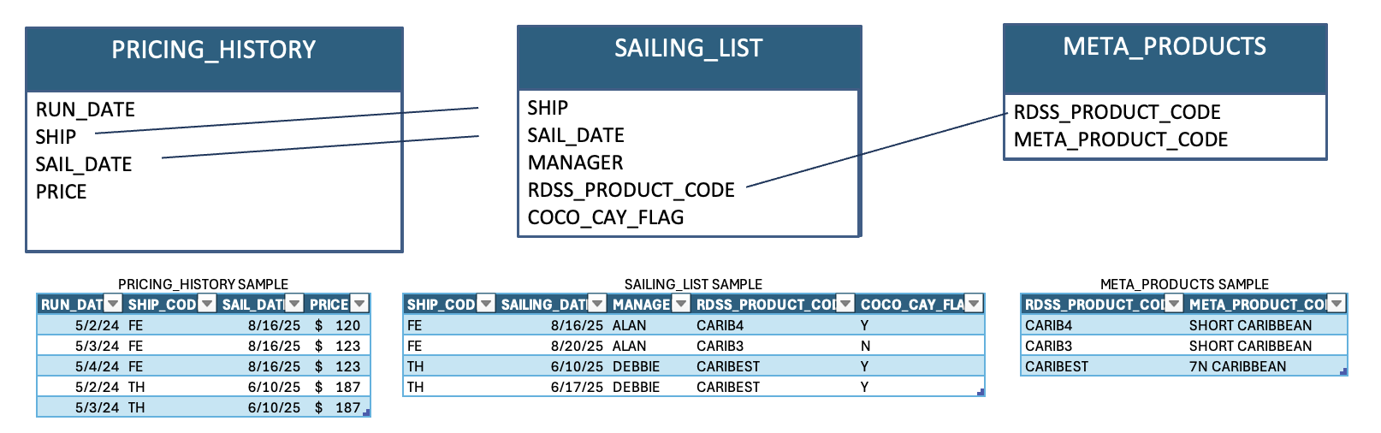
Write a query to see how many Meta_Products and
how many sailings each Manager has for future sailings
SELECT
s.manager,
COUNT(DISTINCT m.meta_product_code) AS meta_products,
COUNT(*) AS sailings
FROM sailing_list s
JOIN meta_products m
ON s.rdss_product_code = m.rdss_product_code
WHERE s.sail_date > CURRENT_DATE
GROUP BY s.manager
ORDER BY s.manager;
2. Write a query that shows the ship that had the most
price changes
WITH price_change_log AS (
SELECT
ship_code,
sail_date,
run_date,
price,
LAG(price) OVER (
PARTITION BY ship_code, sail_date
ORDER BY run_date
) AS prev_price
FROM pricing_history
),
price_changes AS (
SELECT
ship_code,
COUNT(*) AS change_count
FROM price_change_log
WHERE price != prev_price
GROUP BY ship_code
)
SELECT *
FROM price_changes
WHERE change_count = (
SELECT MAX(change_count) FROM price_changes
)
ORDER BY ship_code;
Note: The column ship_code is used consistently in place of ship to align with the sample data schema
and maintain naming clarity across all tables.

Slide 12
3. Write a query to get the average of all price changes made
over the past 5 days for each sailing (*ignore $0 changes*)
WITH price_change_log AS (
SELECT
ship_code,
sail_date,
run_date,
price,
LAG(price) OVER (
PARTITION BY ship_code, sail_date
ORDER BY run_date
) AS prev_price
FROM pricing_history
)
SELECT
ship_code,
sail_date,
AVG(price - prev_price) AS avg_price_change_last_5_days
FROM price_change_log
WHERE run_date >= CURRENT_DATE - INTERVAL '5 days'
AND price != prev_price
GROUP BY ship_code, sail_date
ORDER BY ship_code;

Slide 13
4. Write a query that would allow us to see which manager
hasn't made a price change in the longest time
WITH price_change_log AS (
SELECT
ship_code,
sail_date,
run_date,
price,
LAG(price) OVER (
PARTITION BY ship_code, sail_date
ORDER BY run_date
) AS prev_price
FROM pricing_history
),
price_changes AS (
SELECT *
FROM price_change_log
WHERE price != prev_price
),
manager_last_change AS (
SELECT
s.manager,
MAX(p.run_date) AS last_price_change_date
FROM price_changes p
JOIN sailing_list s
ON p.ship_code = s.ship_code
AND p.sail_date = s.sail_date
GROUP BY s.manager
)
SELECT
manager,
CURRENT_DATE - last_price_change_date AS days_since_last_price_change
FROM manager_last_change
WHERE last_price_change_date = (
SELECT MIN(last_price_change_date)
FROM manager_last_change
)；
price_change_gaps AS (
SELECT
p.ship_code,
p.sail_date,
p.run_date,
p.price,
p.prev_price,
p.run_date - LAG(p.run_date) OVER (
PARTITION BY p.ship_code, p.sail_date
ORDER BY p.run_date
) AS day_gap
FROM price_changes p
),
price_gaps_with_manager AS (
SELECT
s.manager,
g.day_gap
FROM price_change_gaps g
JOIN sailing_list s
ON g.ship_code = s.ship_code
AND g.sail_date = s.sail_date
WHERE g.day_gap IS NOT NULL
)
SELECT
manager,
MAX(day_gap) AS max_gap_days
FROM price_gaps_with_manager
GROUP BY manager
ORDER BY max_gap_days DESC;

Slide 14


Reference Click Link to Download!
Original File & Data:
Track Analyst Case Study.docx
Track_case_study_data.xlsx
Submissions:
wtd_data_cleaning_eda.ipynb
RCG_WTD_Tracking_Dashboard.pbix
cleaned_pax_build_data.csv
WTD Booking Ratio by Product & Sailing Period.csv

Slide 15
Thank You !

